Slide 1




NEXT GEN EMPLOYABILITY PROGRAM
Creating a future-ready workforce
Team Members
College Name
Student Name :Aneena vp
Student ID :720921243008
Jct College of Engineering & Technology-Coimbatore

Slide 2

CAPSTONE PROJECT SHOWCASE
Project Title
Notes Sharing Web Application using Django Framework
Abstract | Problem Statement | Project Overview | Proposed Solution | Technology Used | Modelling & Results | Conclusion

Slide 3
Abstract
In today's digital age, the demand for convenient and effective educational tools is more evident than ever. This study introduces the creation of a collaborative notes sharing web platform to address this need, facilitating the exchange of academic resources among students. Built using the Django framework, a powerful Python web framework known for its speed and practical design, this application provides a solid foundation for users to upload, download, and share notes in various file formats. The system's architecture follows Django's Model-View-Template (MVT) pattern, ensuring a structured and scalable approach that simplifies maintenance. Noteworthy features include user authentication, file organization, a search feature for quick access to specific materials, and a tagging system to categorize notes by subject or course. Initial testing has shown a positive response from users, highlighting the application's potential to enhance the learning experience through collaborative studying and resource sharing. Future plans involve adding more advanced functionalities like collaborative editing, cloud storage integration, and the use of machine learning to suggest tailored content based on user preferences and study patterns.
Source :Gpt 4

Slide 4
Problem Statement
This project addresses a key challenge in the educational landscape: the absence of a dedicated, efficient, and collaborative platform tailored for students and educators to share and manage academic notes. While numerous online platforms exist, few focus on academic collaboration, leaving students to rely on disjointed and potentially insecure methods to exchange study materials. The goal here is to harness the capabilities of Django to create a secure, scalable, and user-centric web application. This platform will not only streamline the sharing and organization of notes but also elevate the learning journey by fostering collaboration and community engagement.
Source :

Slide 5
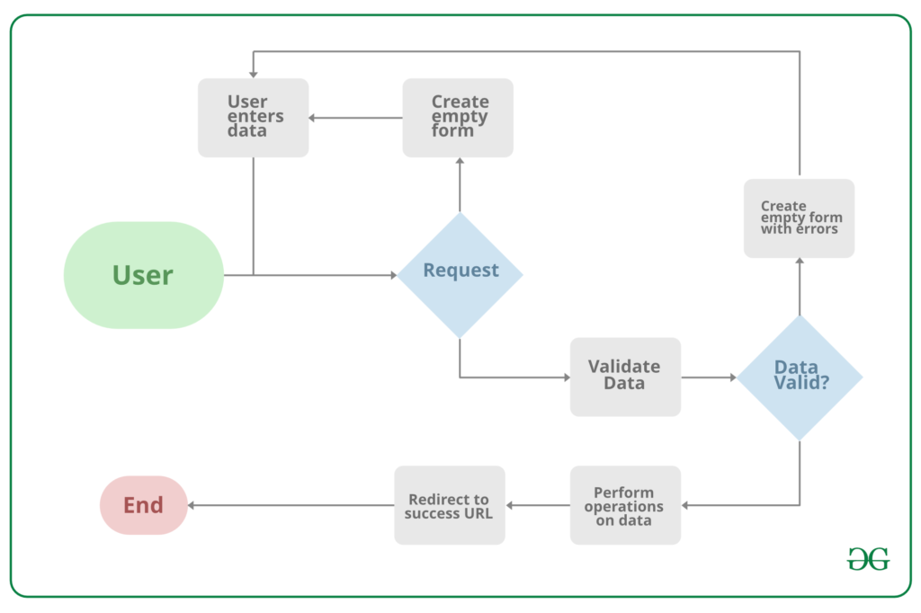
Project Overview
Source :google

Slide 6
Proposed Solution
The proposed solution entails the development of an advanced Notes Sharing Web Application meticulously crafted for students, educators, and academic institutions. This innovative platform will harness the power of Django, known for its reliability, top-notch security measures, and scalability.
1. System Architecture
Backend Engineering: Django will be utilized for handling server-side logic, efficient database management, robust user authentication, and seamless session control, ensuring a highly secure and well-organized backend infrastructure.
Frontend Fusion: Combining HTML, CSS, and JavaScript with Django's template system will result in a visually appealing and user-friendly interface, enhancing the overall user experience with responsiveness Database Schema Design: A meticulously crafted relational database schema will be implemented to efficiently store and manage user data, notes, categories, and interactions, ensuring swift retrieval and secure data storage.
2. Core Functionalities
User Authentication and Authorization: Django's built-in authentication system will be implemented to manage user accounts securely, handle login/logout processes, and safeguard user data privacy.
Notes Handling: Users will be empowered to upload, download, and manage notes in various formats such as PDF, DOCX, PPT, etc. The application will provide seamless options for creating, editing, and removing notes.
Collaborative Tools: The platform will feature tools for users to engage in discussions, rate notes, and leave comments, fostering a collaborative learning ecosystem.
.
Source : GPT 4

Slide 7
3. Security and Privacy
To fortify the application, Django's best security practices will be implemented to thwart common threats like SQL injection, Cross-Site Scripting (XSS), and Cross-Site Request Forgery (CSRF). Additionally, stringent data privacy measures, aligned with regulations such as GDPR, will be enforced to safeguard personal information.
4. Scalability and Performance
The application's architecture will prioritize scalability to seamlessly accommodate growing user numbers and data volume without compromising performance. Leveraging Django's caching framework will further enhance performance by reducing server load and improving response times.
5. User Experience (UX) Design
A user-centric design approach will guide the development of an intuitive and engaging platform. The user interface (UI) will be tailored to meet the specific needs and preferences of the target audience, ensuring an accessible and enjoyable experience. Responsive design principles will be applied to guarantee the application's usability across various devices and screen sizes.
6. Testing and Quality Assurance
To ensure reliability and user-friendliness, thorough testing methodologies will be employed. This includes rigorous unit tests, integration tests, and user acceptance testing (UAT). Django's testing framework will be utilized to automate test cases, ensuring code integrity and a robust application.
Source :GPT 4

Slide 8


Technology Used
Front-end
Back-end
Source :

Slide 9
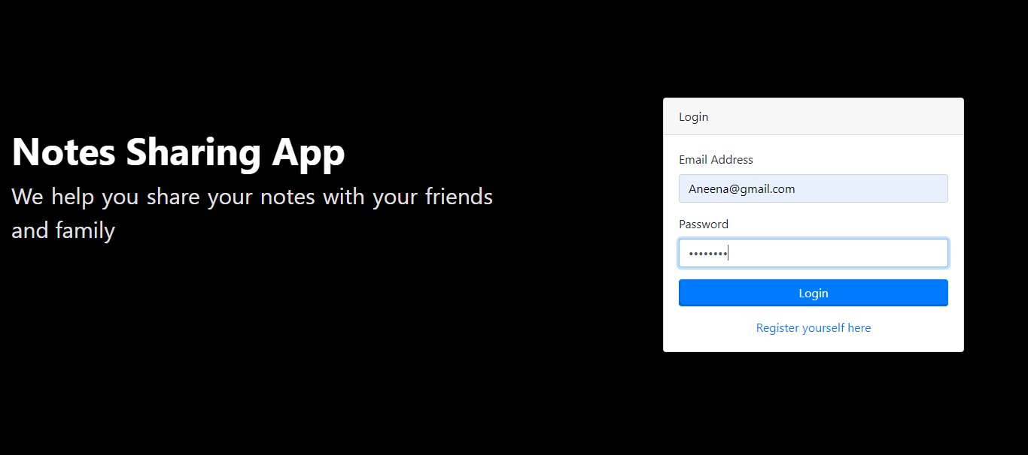
Modelling & Results
Source :

Slide 10
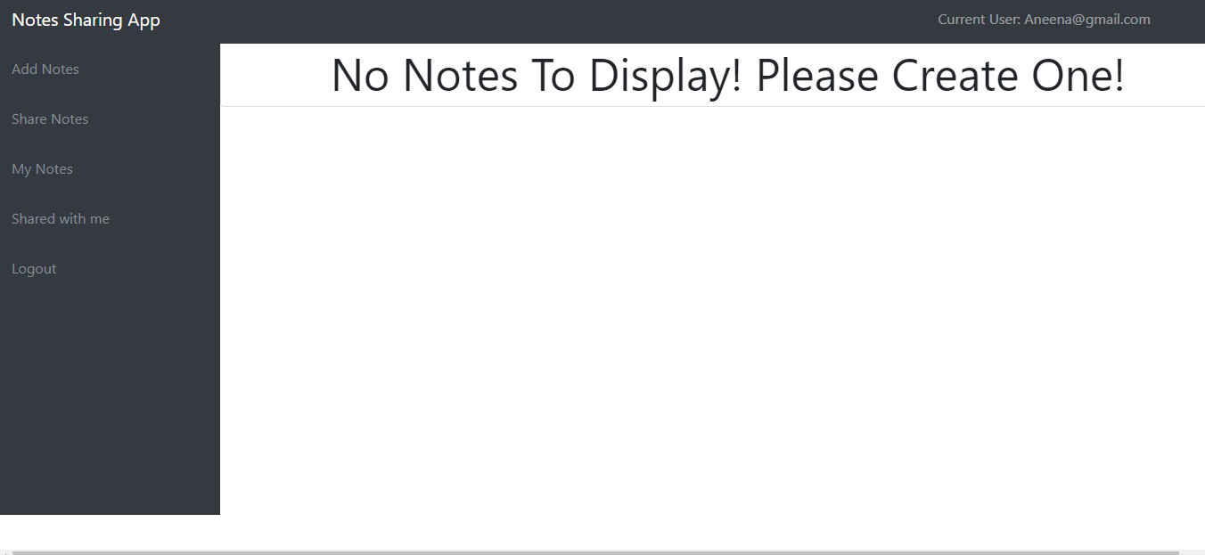
User-Profile

Slide 11
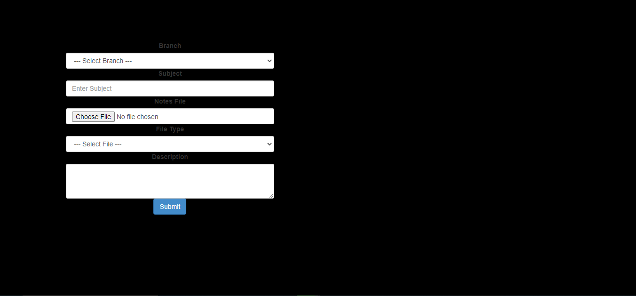
User-Profile

Slide 12
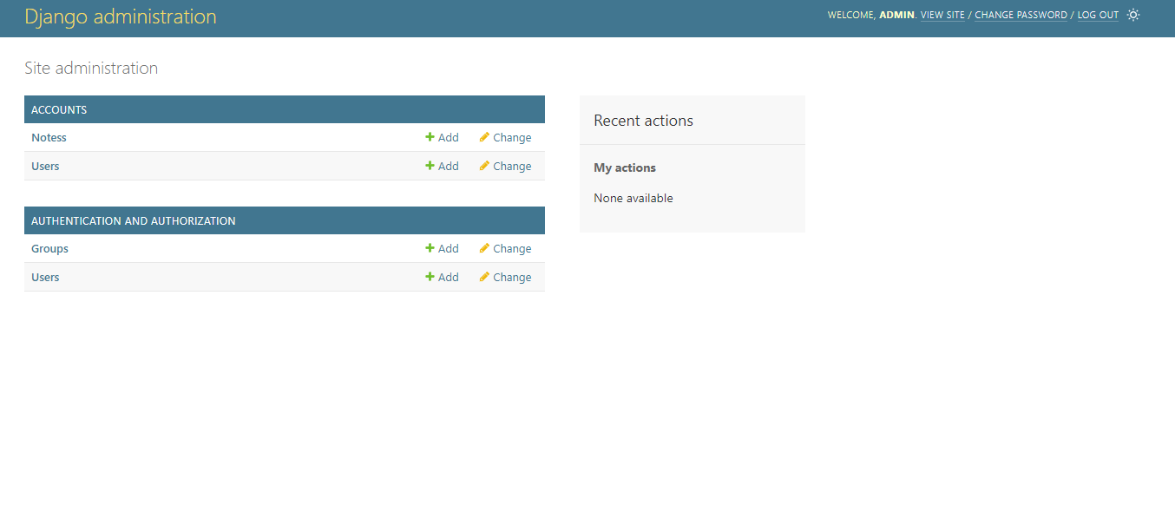
Admin-Page

Slide 13
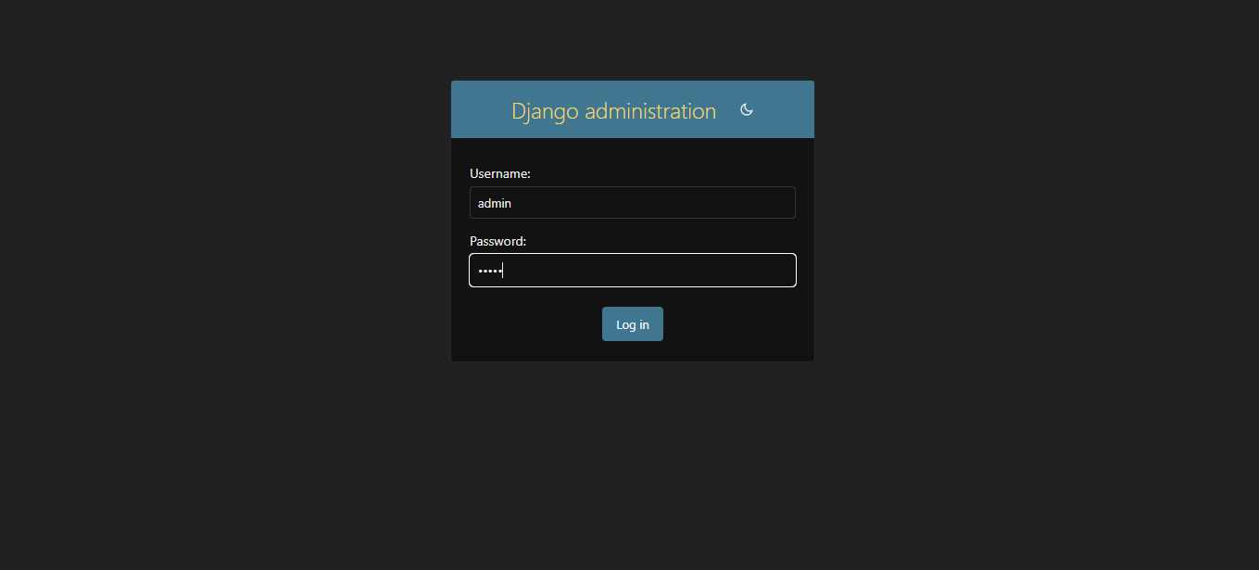
Departments-Page

Slide 14
Future Enhancements:
1. Artificial Intelligence and Machine Learning Integration
To enrich the user experience, advanced AI and machine learning techniques will be integrated into the platform. A sophisticated content recommendation system will be developed, leveraging machine learning algorithms to analyze user behavior and preferences. This system will provide personalized note recommendations tailored to individual users. Additionally, natural language processing (NLP) techniques will be employed to automatically categorize uploaded notes based on their content, streamlining the organization process and enhancing resource discoverability.
2. Enhanced Collaboration Features
To foster greater collaboration among users, real-time collaboration tools will be introduced. This includes features such as simultaneous editing and commenting, akin to the functionality offered by Google Docs. Furthermore, the platform will facilitate the creation and management of study groups, allowing users to collaborate in a structured and organized manner, thereby enhancing the overall learning experience.
3. Integration with External Platforms
The platform will offer seamless integration with popular cloud storage services such as Google Drive and Dropbox, enabling users to easily upload and backup their notes. Additionally, integration with other educational platforms and tools will be provided, allowing users to access a diverse array of resources and tools directly from within the application. This integration will streamline workflows and enhance the overall utility of the platform for users.

Slide 15
Conclusion
In conclusion, note sharing applications are invaluable tools that facilitate collaboration, knowledge exchange, and organization across various domains. Whether used for educational purposes, professional endeavors, or personal organization, these platforms provide a centralized hub for users to create, share, and collaborate on notes. By promoting efficient communication, enhancing productivity, and fostering learning and growth, note sharing applications empower individuals, teams, and communities to connect, collaborate, and succeed in the digital age. As technology continues to advance, the importance and impact of note sharing applications are expected to increase, offering crucial support for collaboration and knowledge sharing in diverse contexts.
Source :

Slide 16
Thank You!
Notes:
Thank You !!

